Slide 1
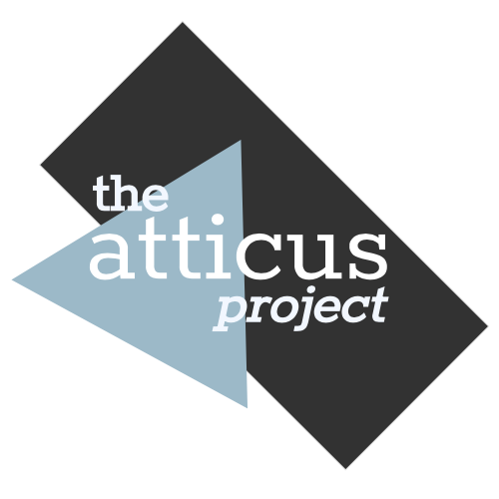
Training AI to Review Contracts
Why do we need training datasets?
© 2020 The Atticus Project

Slide 2
Review of Last Presentation
Find the last presentation here: NLP Deep Dive
We previously learned how AI, with NLP, breaks down text and learns to "understand" contracts using labels.
In this module we will explain why a training dataset is needed to teach AI to “understand” contracts.

Slide 3
Defining Terms in the Context of Contract Review
Labeling:
The process of manually highlighting selected provisions in a contract, such as "expiration date", "renewal term", “most favored nation”, etc.
Training Dataset:
A collection of legal contracts labeled with selected provisions;
Used to train AI to recognize such provisions in other contracts.

Slide 4

Purpose of a Training Dataset
AI uses the training dataset to train models that look for identifiable patterns within a given label.
The model can then “learn” to identify that provision in other contracts.
For example, one such pattern is that the governing law typically contains the words "State of". In this example below, the governing law is of the “State of California”
The pattern that the AI looks for is the format of the phrasing.

Slide 5
Atticus Dataset is a Training Dataset
Atticus Dataset is a collection of:
commercial legal contracts that
have been manually labeled with 30+ different types of provisions.
These provisions are considered important by experienced attorneys in due diligence review in connection with a corporate transaction
A corporate transaction includes mergers & acquisitions, investments, initial public offering, etc.

Slide 6

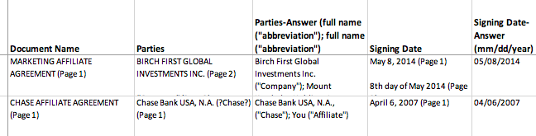
Atticus Dataset is a Training Dataset (Conti.)
The Atticus Dataset contains two files:
The contracts: A PDF of all the underlying contracts that we used to extract the labels. These contracts in pdf are not labeled.
a CSV file, where the first column is the name of a contract corresponding to a pdf file in “The contracts” file and the remaining 30+ columns correspond to the various labels in such contract.

Slide 7
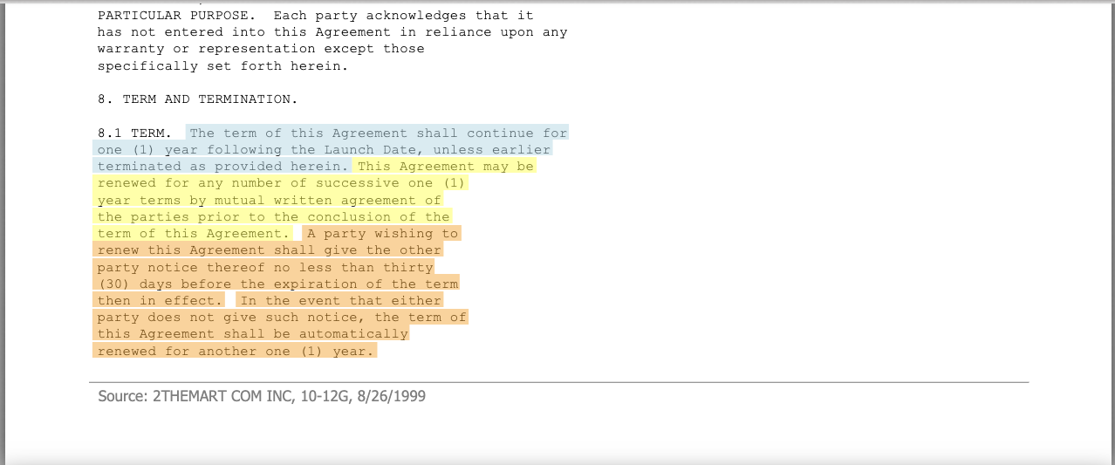
Creating the Atticus Dataset
Atticus volunteers use a contract review tool, eBrevia, to manually label the relevant provisions in a legal contract.
Expiration Date
Renewal Term
Notice to Terminate Auto-Renewal

Slide 8
Creating the Atticus Dataset (Conti.)
Source of Contracts
The contracts were sourced from EDGAR, the Electronic Data Gathering, Analysis, and Retrieval system, used at the U.S. Securities and Exchange Commission (SEC).
Publicly traded companies in the United States are required to file certain contracts under SEC rules.
Access to these contracts is available to the public for free at https://www.sec.gov/edgar.

Slide 9
Creating the Atticus Dataset (Conti.)
Contract Selection
The Atticus Dataset includes commercial contracts selected from 25 different types of contracts (e.g. Manufacturing Agreement, License Agreement, Co-Branding Agreement) based on the contract names.
Within each type, we randomly selected contracts based on the names of the filing companies - but ensured no company was chosen more than once, to provide a broad range of contract styles.

Slide 10
Creating the Atticus Dataset (Conti.)
Labeling Process
Our labeling process included multiple steps to ensure accuracy:
1
Student Labelling
2
Keyword Search
3
Group Review of Report
Student volunteers conducted two levels of manual contract review and labeling in eBrevia, an online contract review tool. This step was conducted initially in sequence, and now in parallel.
Student volunteers conducted keyword searches in eBrevia to capture additional labels that were missed during the “Student Label” step. This step was conducted initially after the “Student Label” step, and now as part of the parallel reviews during the “Student Labelling” step.
Student volunteers exported the labels into reports on a periodic basis and reviewed the reports in groups of three. This process was conducted initially via Zoom in a group of three, and now in parallel by three students separately. If one or more students disagreed with a labeled provision, that provision would be highlighted for Attorney Review.

Slide 11
Creating the Atticus Dataset (Conti.)
Labeling Process
Our labeling process included multiple steps to ensure accuracy:
4
Attorney Review
5
Label-by-Label Review
6
Attorney Review
One experienced attorney reviewed the highlighted provisions and provided comments. Student volunteers reviewed the comments and made changes in eBrevia accordingly.
Student volunteers exported single-label reports and reviewed them in a group of three. This process was conducted initially via Zoom in a group of three, and subsequently in parallel by three students separately. If one or more students disagreed with a labeled provision, such provision would be highlighted for Attorney Review.
Two experienced attorneys reviewed the highlighted provisions and provided comments. Attorneys then discussed such results with the student volunteers and reached consensus. Student volunteers made changes in eBrevia accordingly.

Slide 12
License
Atticus Labels and Atticus Dataset (to be released) are licensed under the Creative Commons Attribution 4.0 (CC BY 4.0) license and free to the public for commercial and non-commercial use.
Note: We make no representations or warranties regarding the license status of the underlying contracts, which we download from EDGAR.

